Slide 1
Foot and Mouth Disease
What dairy producers need to know
Notes:
Welcome to this video introduction covering the basics of Foot & Mouth Disease. Of all the natural or man-made disasters which could befall the U.S. dairy industry, none would be more devastating than the introduction of a rapidly spreading foreign animal disease like Foot and Mouth.

Slide 2
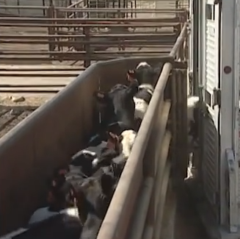
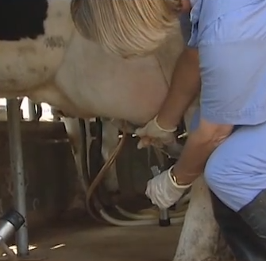
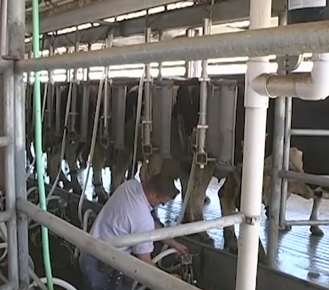
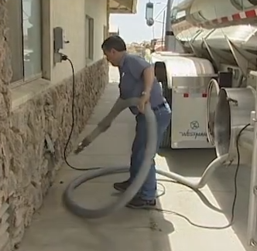
What will this video cover?
How FMD is spread between animals
Regulatory actions
Protection during an outbreak
Ship milk through the SMS Plan
Notes:
This video will describe how Foot and Mouth is spread between animals, the types of regulatory actions that may be taken during an outbreak and how you may be able to protect your farm and even ship milk during an outbreak through the Secure Milk Supply Plan.

Slide 3
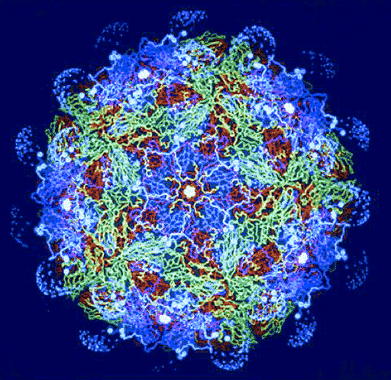
Foot and Mouth Disease Virus
Most contagious disease virus known in animals
Affects all animals with cloven feet (cattle, sheep, goats, pigs)
Causes blistering on feet, mouth, and teats
Not a public heath or food safety concern
FMD Virus
Notes:
The Foot and Mouth Disease virus, while harmless to people, is the most contagious disease in the animal kingdom. The virus affects all animals with cloven feet, such as cattle, sheep, goats, and pigs, causing blistering on feet, mouth, and teats. It is not a public health or food safety concern.

Slide 4
Foot and Mouth Disease Virus
There is no treatment
Historically control has consisted of quarantine, test, and depopulation
FMD Outbreak, UK 2001
Notes:
There is no treatment. Historically, control has consisted of quarantine herds, testing animals & depopulation of positive herds and adjacent herds.

Slide 5
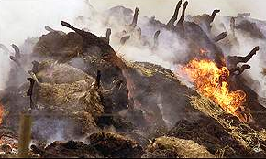
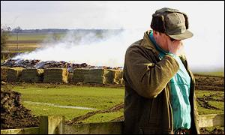
Foot and Mouth Disease in UK 2001
10 million animals depopulated (infected and non-infected) from 2,000 farms
Emerging and Exotic Diseases of Animals 2010
$13 billion economic losses
(U.S., 2001 dollars)
UK National Audit Office 2001
Suicides among producers and emergency workers
Notes:
The 2001 British Foot and Mouth outbreak demonstrated what can happen when a Foreign Animal Disease like Foot and Mouth is introduced into a modern country. An estimated 10 million animals were depopulated from about 2,000 farms. Many animals were depopulated, not because they were infected, but as a precaution because they were close to infected herds. Total economic losses have been estimated at approximately 13 billion US dollars. There was also an exceptionally high rate of suicides for both affected producers and people participating in the depopulation.
Next we will watch and excerpt from ABC that demonstrates the personal cost that many British livestock producers experienced.

Slide 6


Slide 7
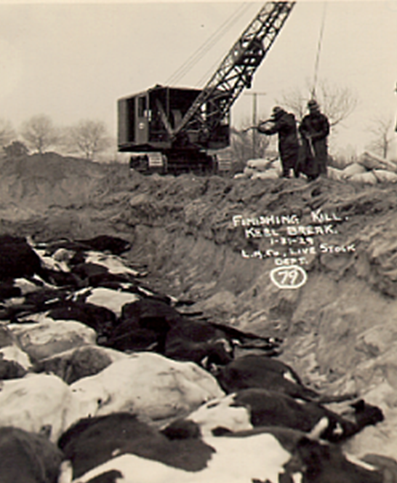
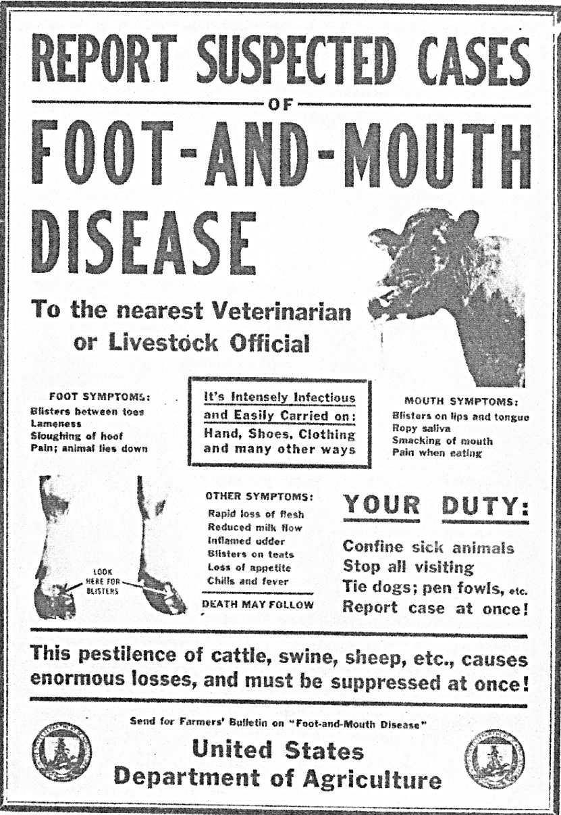
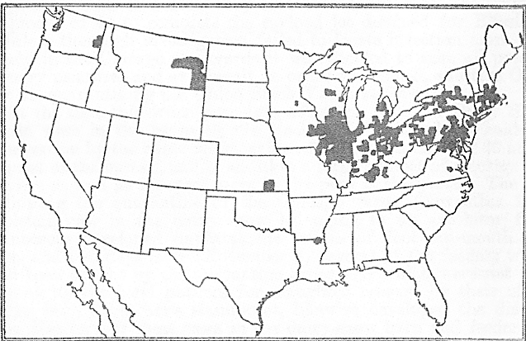
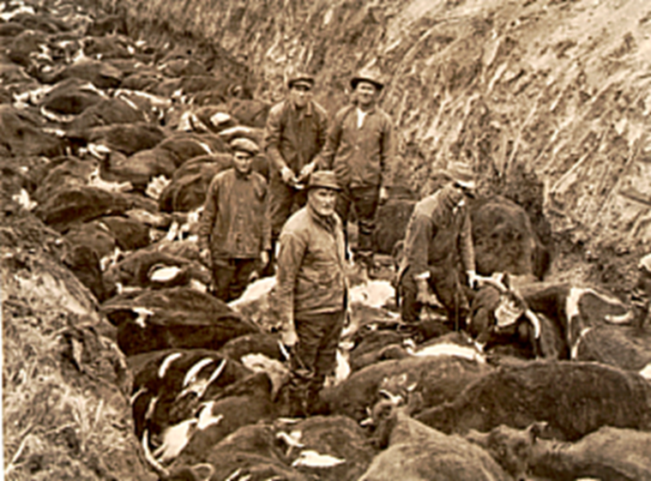
Could FMD Occur in the U.S.?
It already has
FMD outbreak, US 1914
California FMD Outbreaks 1924 & 1929
Notes:
Could Foot and Mouth Disease occur in the United States? It already has. Since 1900 there have been six U.S. outbreaks, the largest in 1914, when the virus gained entry into the Chicago stockyards. The most recent outbreaks were in California in 1924 and 1929. Since the turn of the century these outbreaks have involved 25 different states, nearly 6,000 herds and more than 300,000 animals.

Slide 8
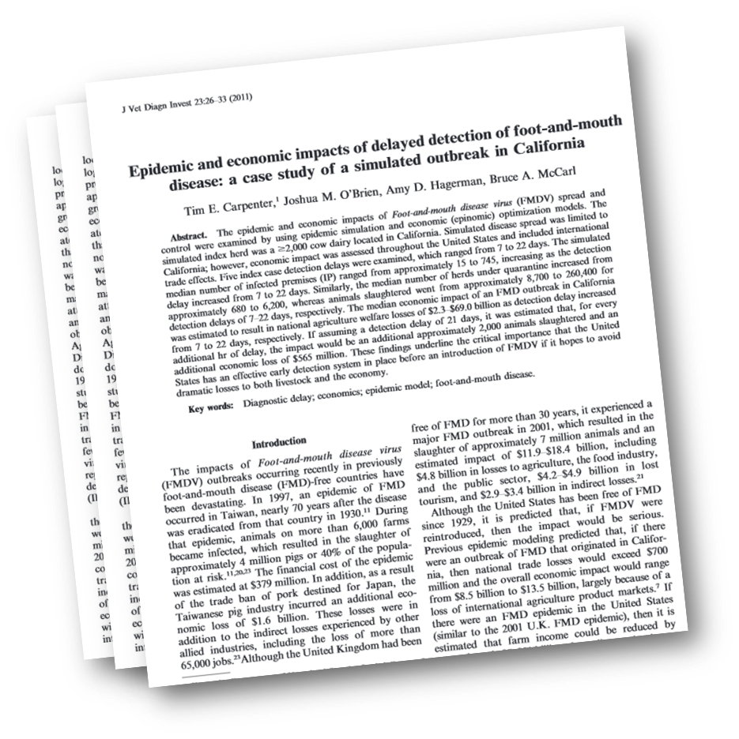
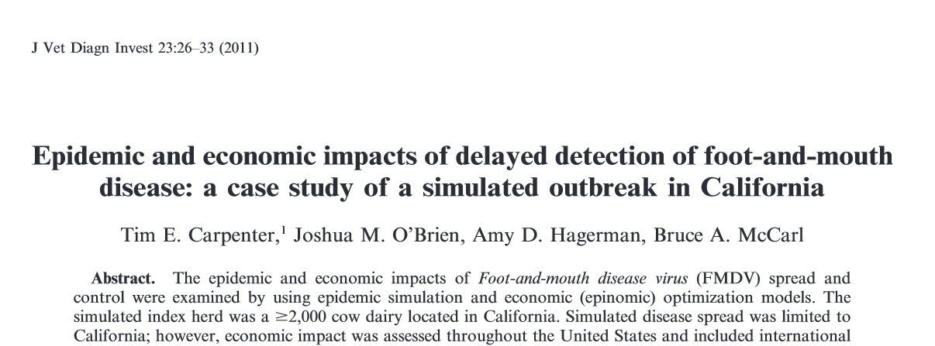
Could FMD Occur in the U.S.?
Foot and mouth today would spread much faster than in the past
Every hour undetected = $565 million
Carpenter et. al. 2011
Notes:
Now that cattle, feed and product move more quickly than they did at the beginning of the century, Foot and mouth today would spread much faster. Computer modeling by the University of California estimates that if Foot and Mouth were introduced today, every hour it went undetected would ultimately cost responding agencies and the industry 565 million dollars in lost product, destroyed cattle and depopulation costs.

Slide 9
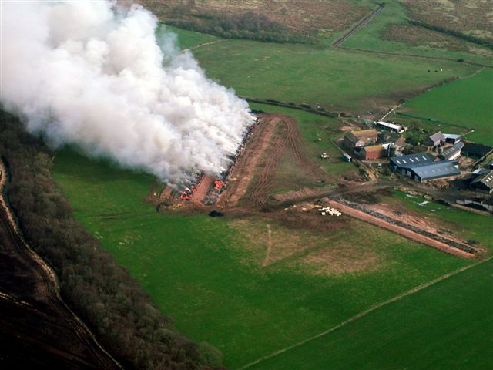
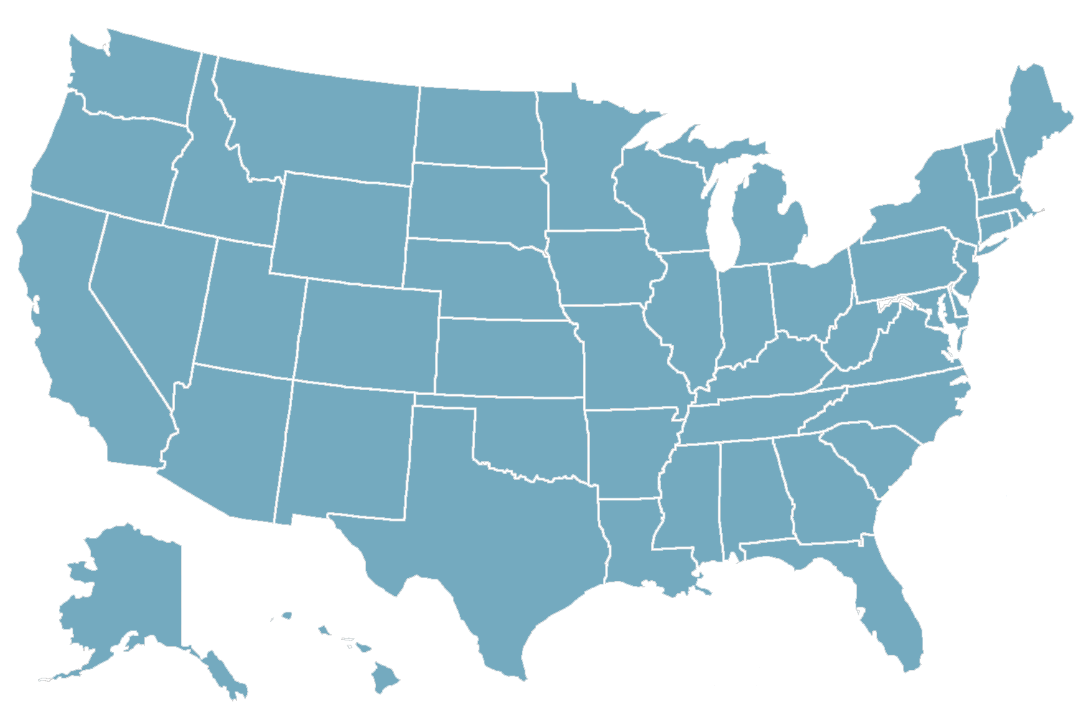
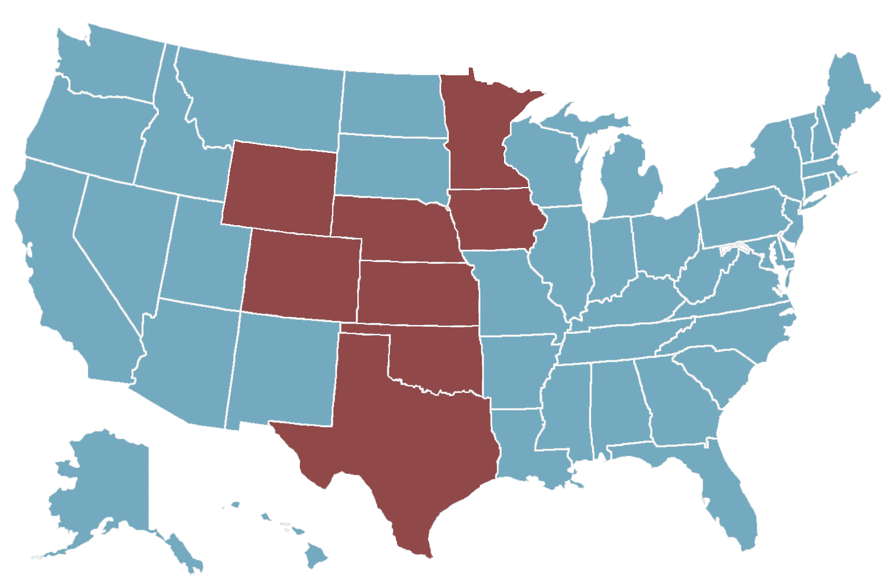
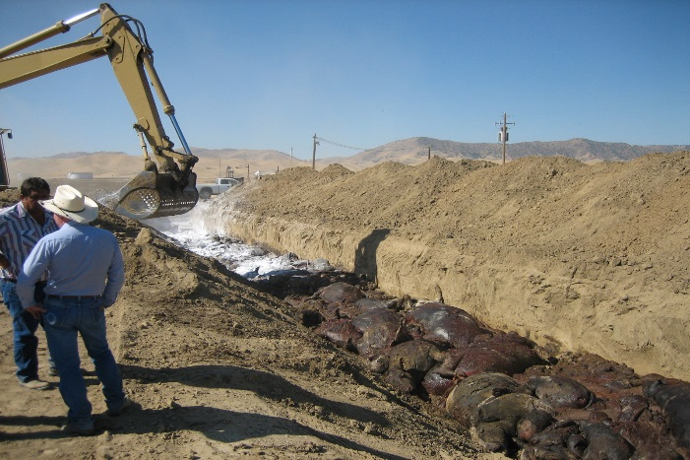

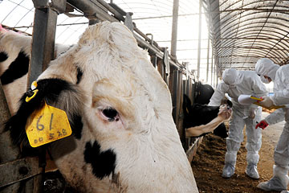

U.S. Regulatory Actions for FMD
Depopulation
Vaccination
Notes:
Given the destruction and despair faced in the U.K. during their 2001 outbreak and how other outbreaks have been handled around the world, the United States is considering other disease management options besides massive depopulation. In a small outbreak, depopulation is one approach to stop the spread of the disease. However, in a large, widespread outbreak affecting many herds in many states, vaccination is another disease control tool being considered by USDA. More information about FMD vaccination will be covered in more detail in another video.

Slide 10
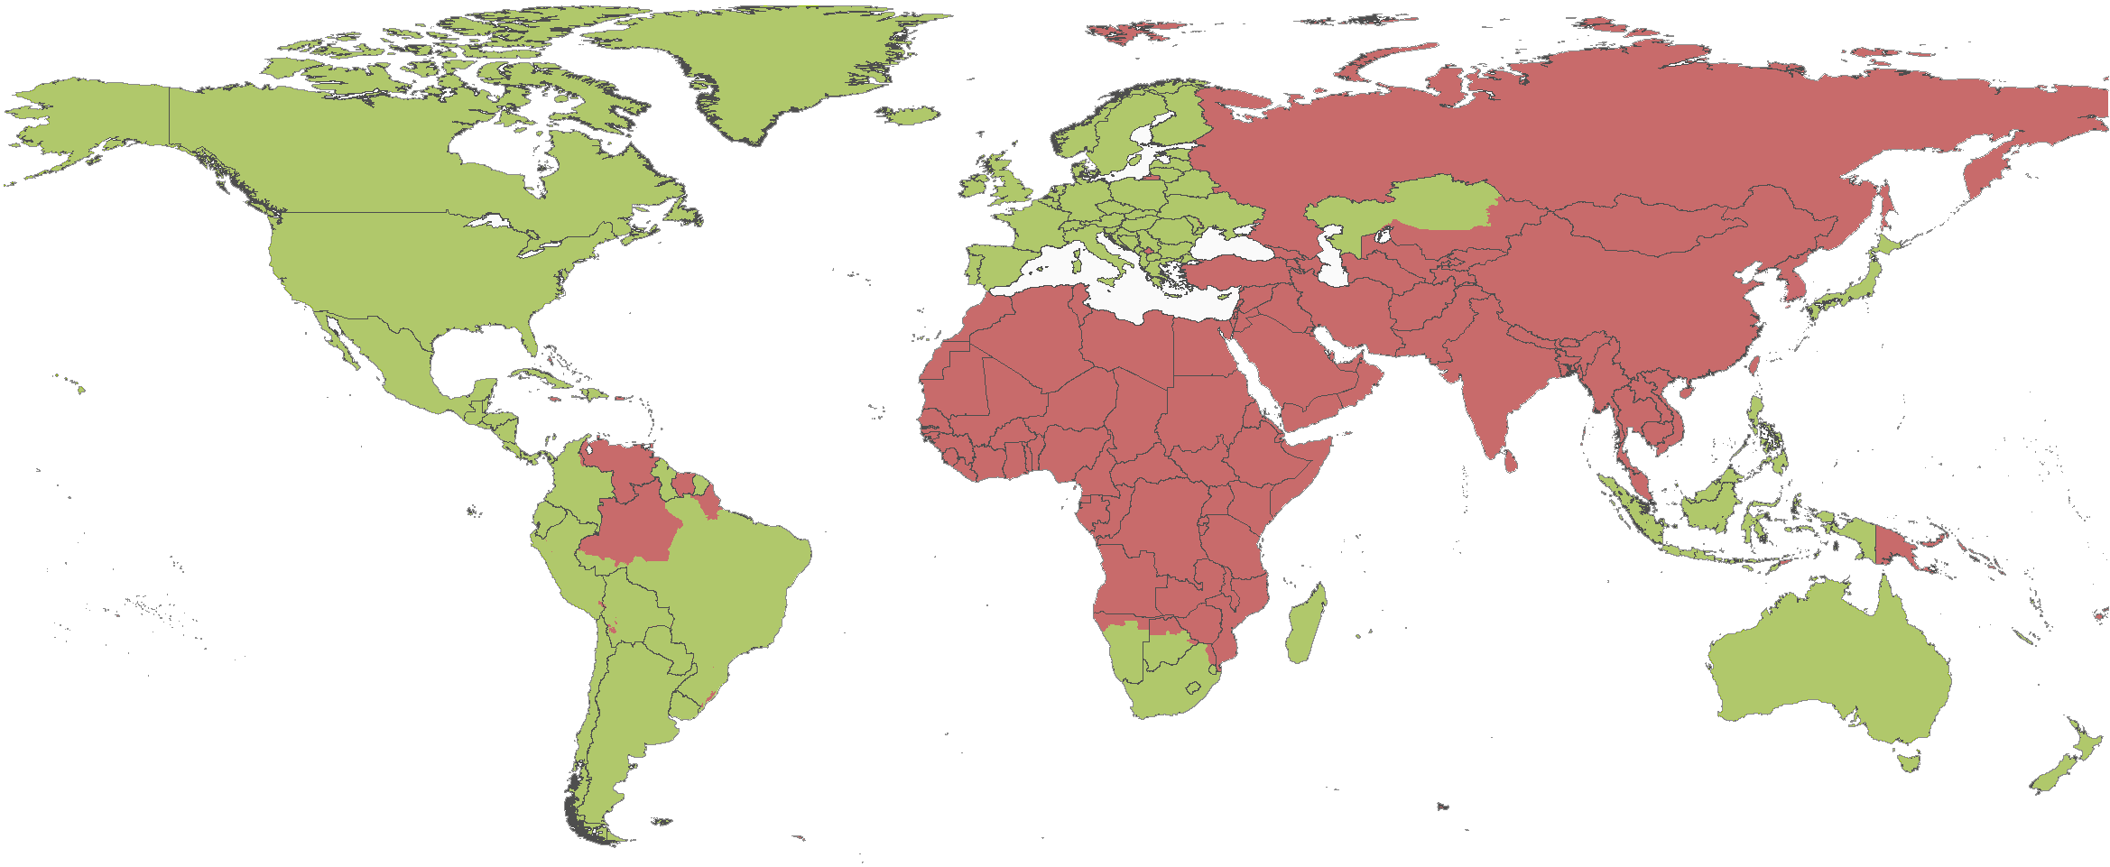
FMD Around the World
FMD Free
FMD Present or Suspected
From OIE Official FMD Status Map, updated 2015
Notes:
As shown here in red, we can see that at any given time there are actually more countries in the world infected with Foot and Mouth Disease than are free of it. These infected counties serve as a reservoir, sporadically causing disease outbreaks in previously free areas.

Slide 11
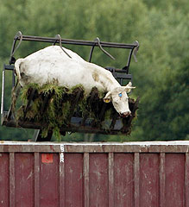
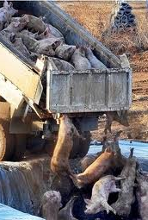
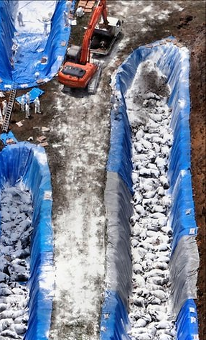
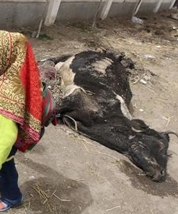
FMD Around the World
UK ‘07
Korea ‘10
Japan ‘10
Egypt ‘12
Notes:
Some major outbreaks in countries designated as free include a second United Kingdom outbreak in 2007, separate outbreaks in 2010 in South Korea and Japan and Egypt in 2012.

Slide 12
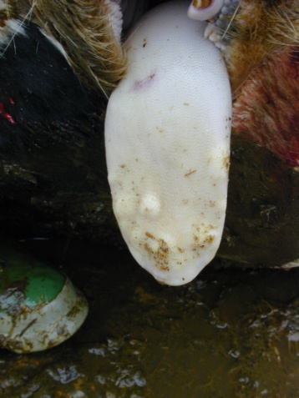
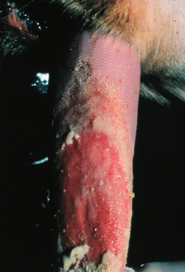
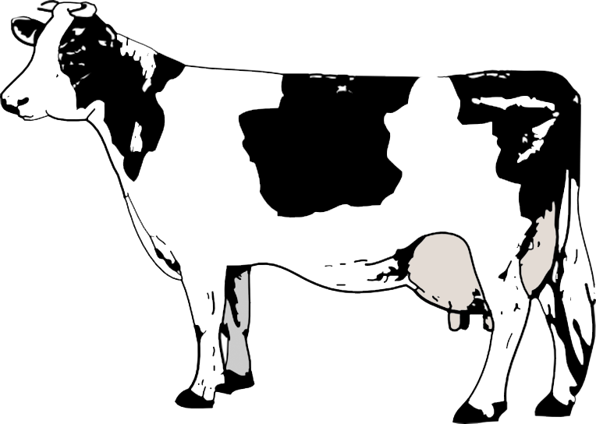
Signs of Foot and Mouth Disease
Mouth
Notes:
So, what does Foot and Mouth disease look like in cattle? As the name suggests, the virus causes blisters on the skin in the mouth and on the tongue. These blisters can break open leaving painful ulcers. In advanced cases much of the skin or mucus membranes can slough leaving large exposed areas.

Slide 13
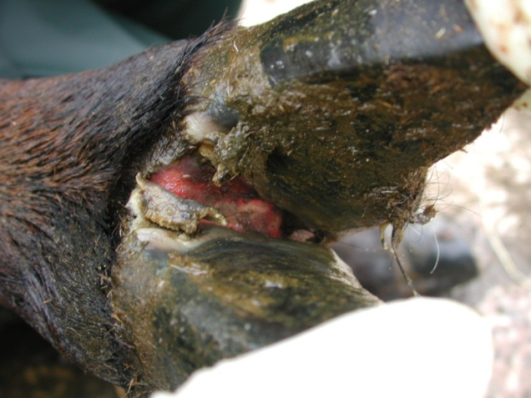
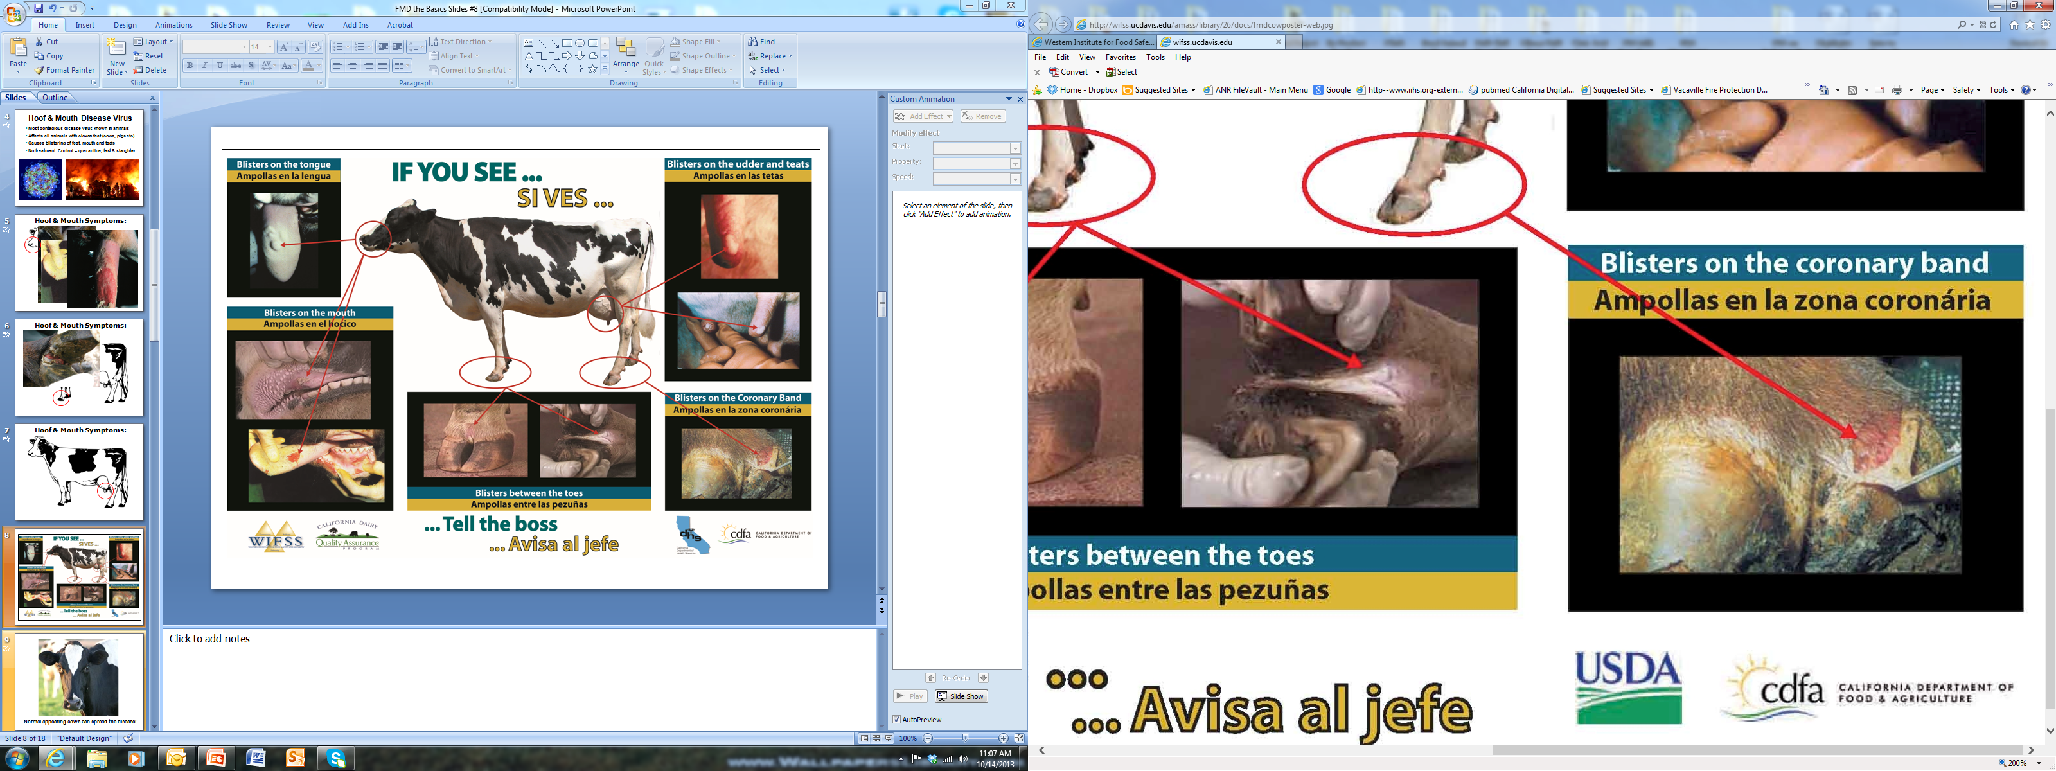
Signs of Foot and Mouth Disease
Feet
Notes:
Also as the name suggests the disease can also attack the feet causing blisters, ulcers and sloughing of the skin, especially between the claws and at the margin of the skin and the hooves.

Slide 14
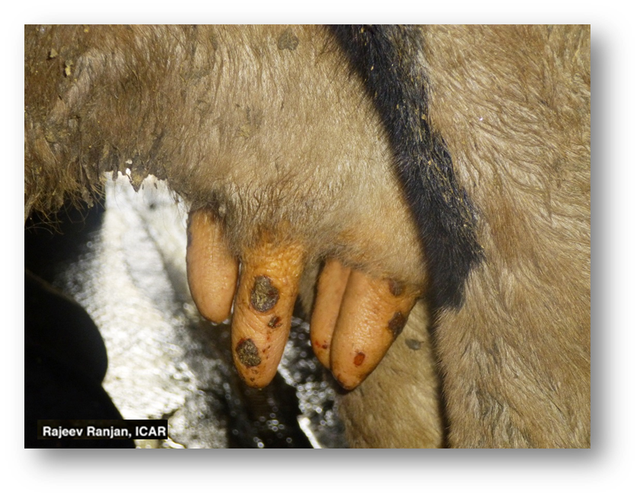
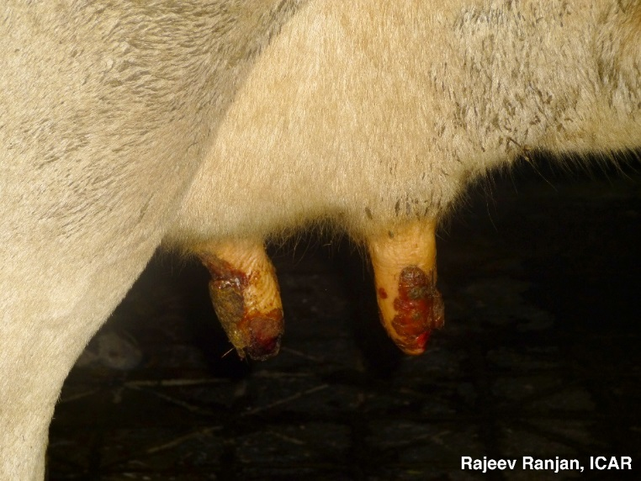
Signs of Foot and Mouth Disease
Teats
Notes:
Lastly, blisters and ulcers can frequently be found on the teats. While Foot and Mouth Disease only rarely kills adult animals, these painful lesions cause animals to go off feed causing their weight gain and milk production to plummet.

Slide 15
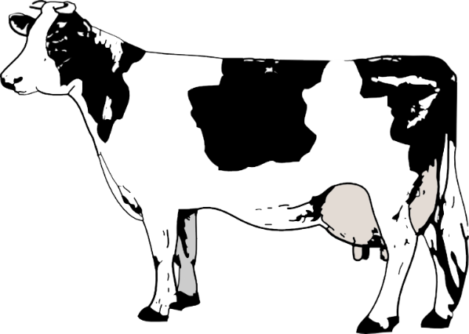
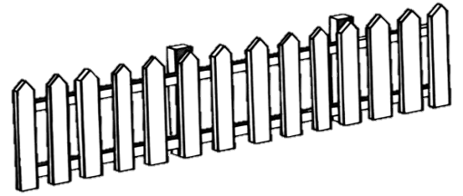
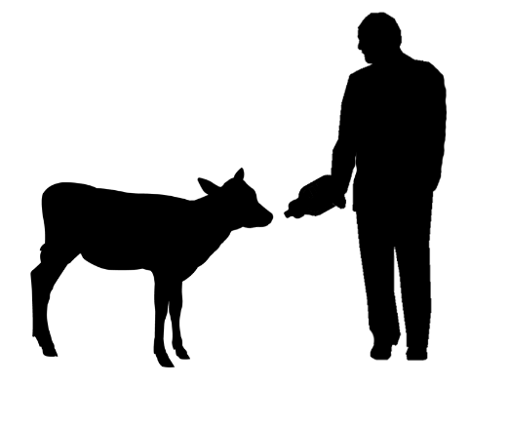
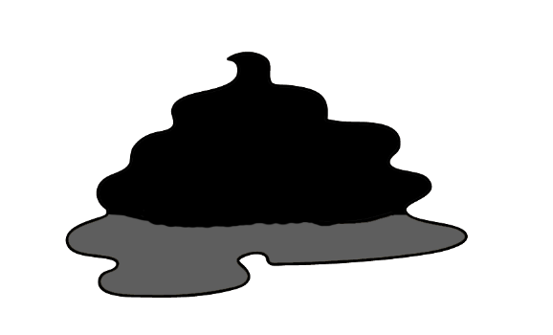
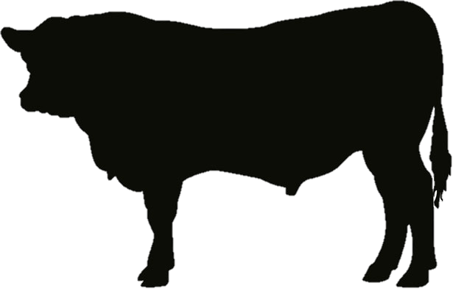
How is FMD Spread?
Infected cattle
Uninfected cattle
Saliva / Breath / Blister Fluid
Fence Line
Shed the virus 2 to 4 days before clinical signs appear
Urine and Manure
Milk
Semen
Notes:
So, how can the Foot and Mouth Disease virus be spread to healthy cattle? An infected cow can spread the disease through saliva, breath or the fluid from blisters on the cow’s mouth, teats or feet. This type of direct transfer can occur across a fence line within a herd, or, across a fence line from a neighboring herd. The virus is also found in the urine and manure of infected cattle, in their milk and even in bull semen, including frozen semen. So you can see that virtually any bodily fluid from an infected cow can infect other animals.

Slide 16
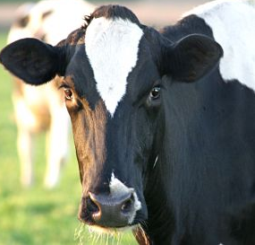
How is FMD Spread?
Normal appearing cattle can spread the disease
Shed the virus 2 to 4 days before clinical signs appear
Biosecurity is critical
Notes:
Perhaps the most important thing to know about Foot and Mouth Disease however, is that normal appearing cattle can spread the disease, shedding the virus in bodily fluids 2 to 4 days before clinical signs appear. This is why bio-security measures are so important during a Foot and Mouth outbreak in an area.

Slide 17
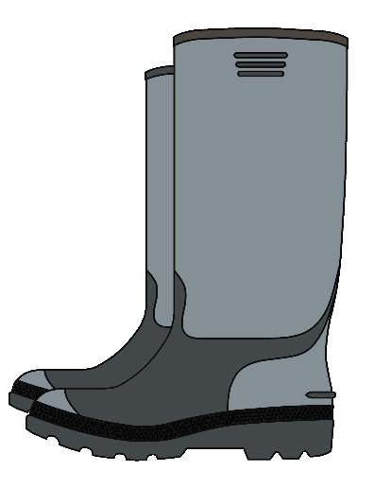
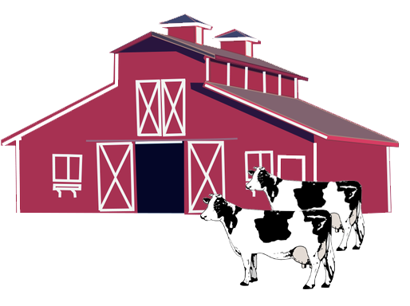
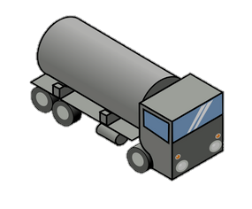
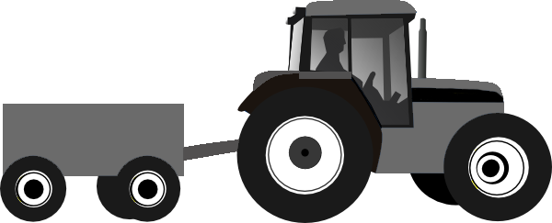
FMD can be Carried on Equipment
Infected farm
Uninfected farm
Clothing
Vehicular traffic
Equipment
Notes:
Critical information for producers is that the Foot and Mouth Disease virus can also be carried on equipment from an infected farm to an uninfected farm. The virus can be carried on clothing like boots and coveralls, and on vehicles and equipment shared between farms.

Slide 18
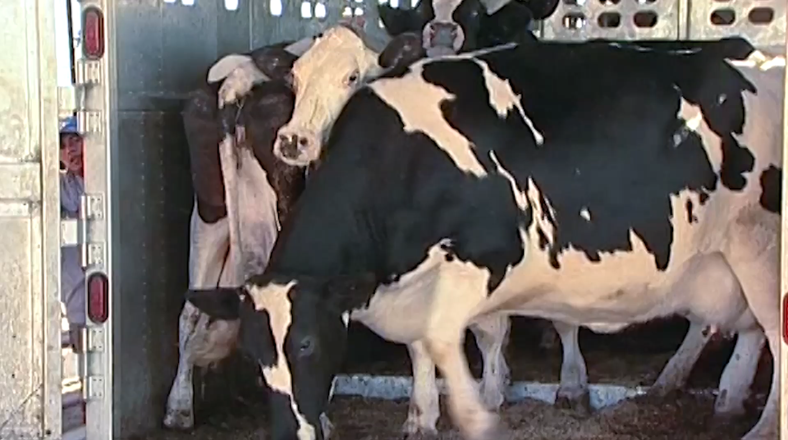
FMD can be Carried on Equipment
Notes:
Dairy visitors who can carry the virus on their vehicles or clothing include feed deliveries and livestock trailers, vet trucks, foot trimers, dead haulers and service and repair personnel. One of the biggest concerns is virus transfer on a milk tanker which might be traveling to other dairies or which cross paths with contaminated trucks at the processing plant.

Slide 19
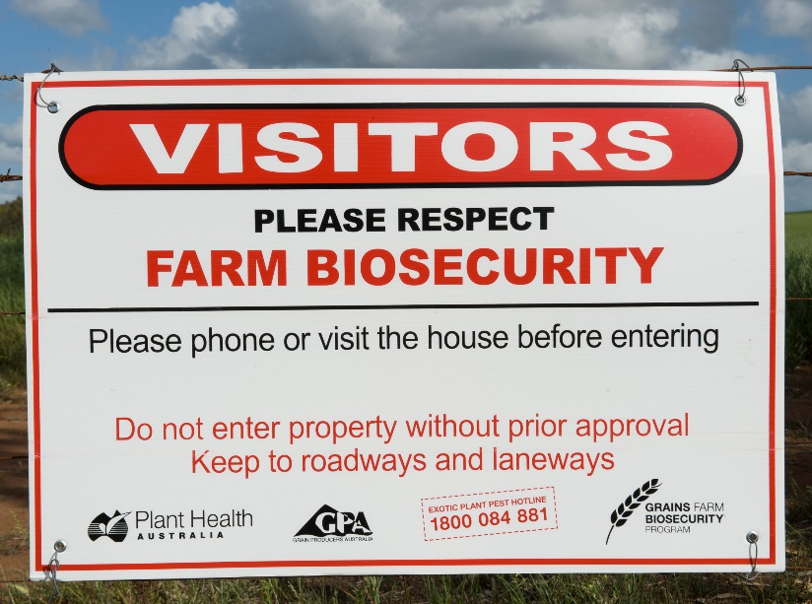
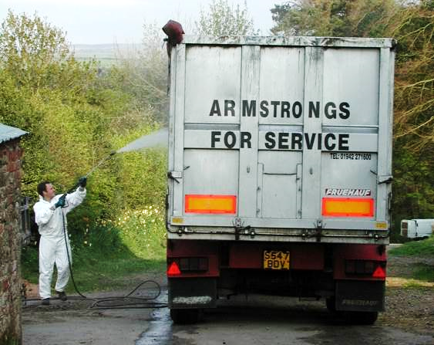
Protecting Your Herd
UK farmers with good biosecurity procedures were 5 times less likely to become infected
Unpublished research:
Carlisle Epidemiology Team, DEFRA
UK 2001 Outbreak
Notes:
Now that you how the virus can be spread, you might be wondering, can I use this information to protect my herd during an outbreak? In the United Kingdom farms practicing good bio-security procedures were 5 times less likely to become infected.

Slide 20
Protecting Your Herd
You CAN protect your herd
Can you still ship milk during an outbreak?
Notes:
The take home message is that you absolutely can protect your herd during an outbreak.
But even if a dairy farmer can prevent the disease from entering his farm, will he be able to ship milk during a FMD outbreak?

Slide 21
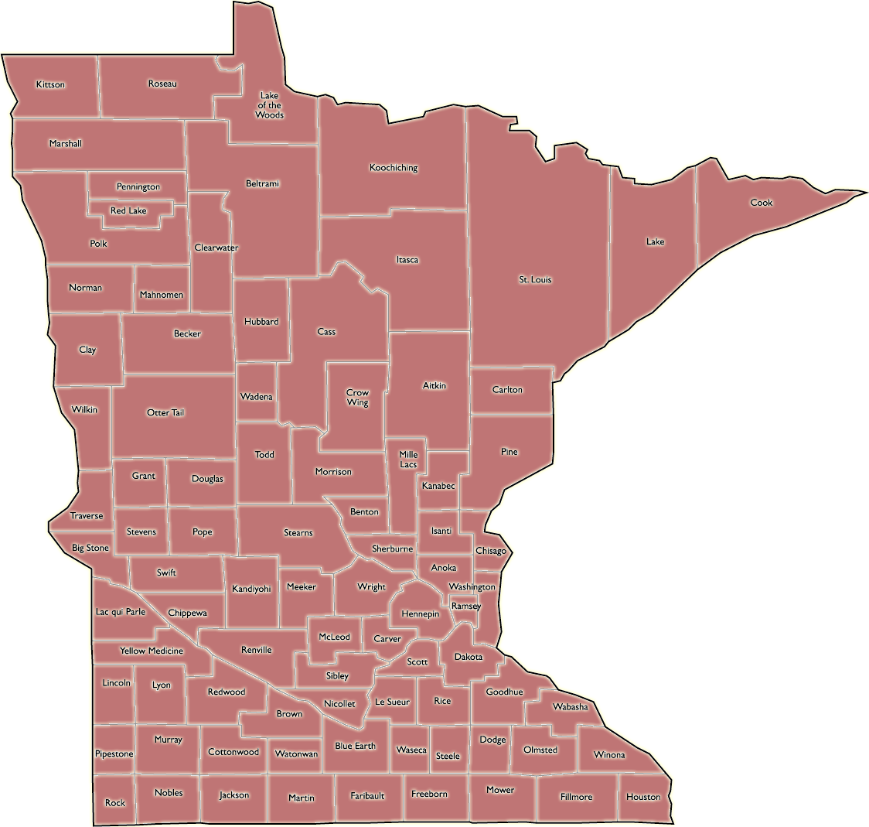

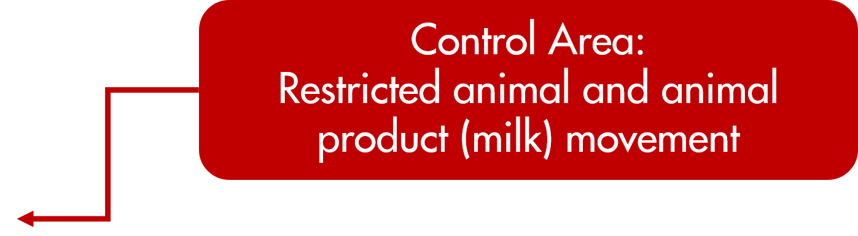

Control Areas and Movement Restrictions
Notes:
During a Foot and Mouth Disease outbreak “control areas” would be established to limit disease spread. In these areas movement of animals and animal products would be restricted by “Stop Movement, or “Quarantine” orders. This would include raw milk movement from dairy farms to their processors.

Slide 22
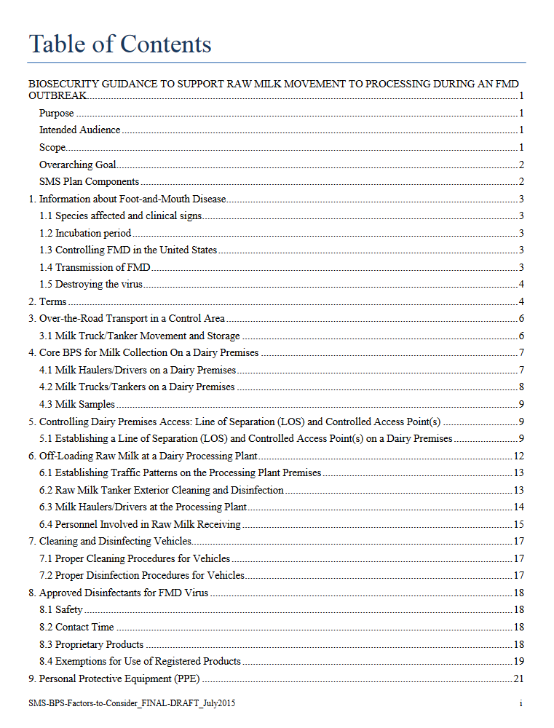
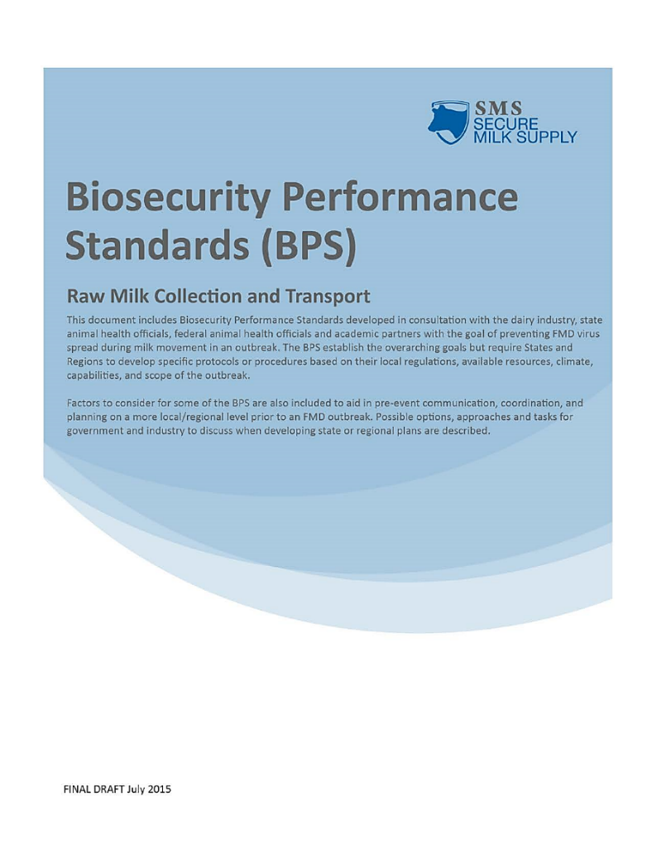
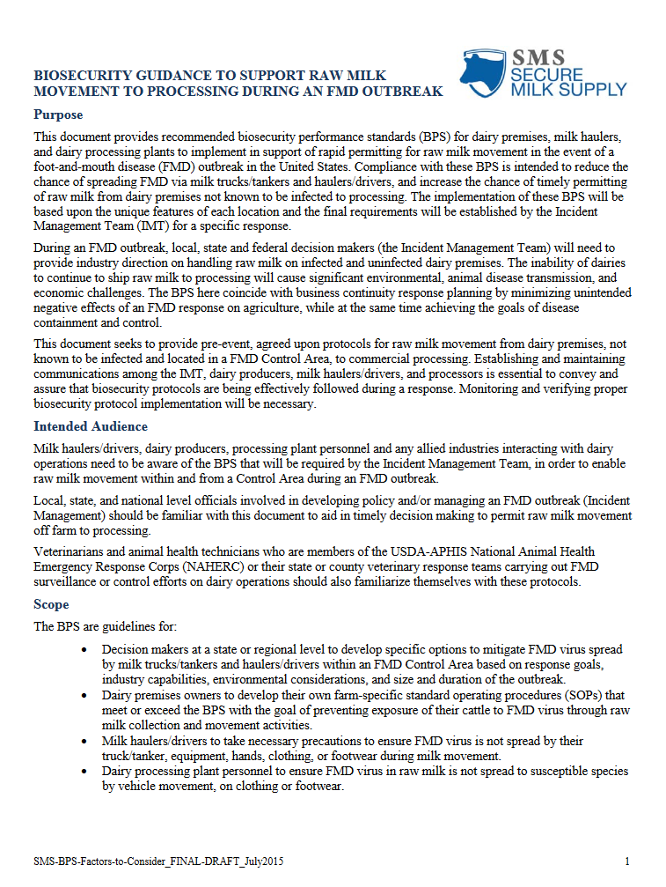
The Secure Milk Supply Plan
Program is voluntary
Provides tools to help protect your dairy
Continued shipment of milk and business continuity
Notes:
Recognizing that this would be devastating to the area’s dairy industry, the USDA and collaborating states have developed a plan called the Secure Milk Supply Plan. The program is voluntary. It provides tools to help you protect your herd. The goal of the SMS Plan is continued movement of milk and milk products. The SMS Plan provides guidance for producers, haulers, processing plants and those issuing movement permits during an outbreak.
Future videos will cover more of the details of the SMS Plan.

Slide 23
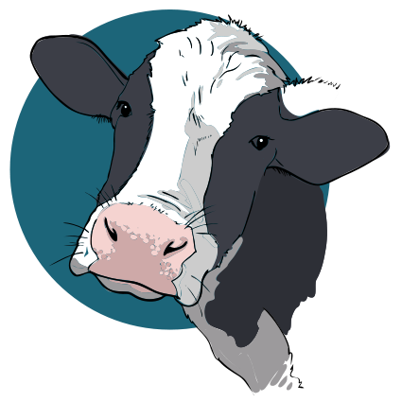

Yes, You Can Protect Your Herd
Open for Business
Visit:
http://securemilksupply.org
For more information
Notes:
Yes, you can protect your herd and your business during an outbreak! Talk with your processor field representative or State Department of Ag about participating in the Secure Milk Supply Plan, or visit http://securemilksupply.org for more information.

